Slide 1


Bolton College
Preparing you for the world of work, Apprenticeships and
Higher Education.

Slide 2


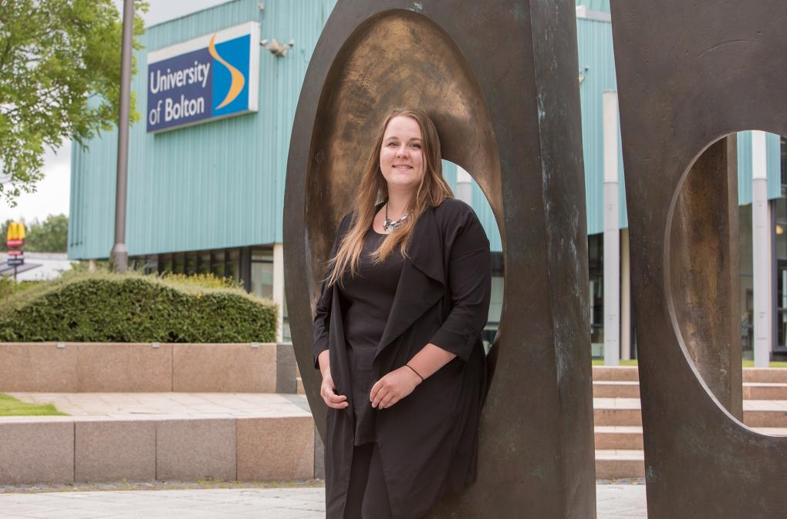
University Group Benefits
We’ll provide:
• Masterclasses and guest lectures
• University visits and use of modern facilities
• Access to mentoring and coaching
• Extra support with university applications

Slide 3
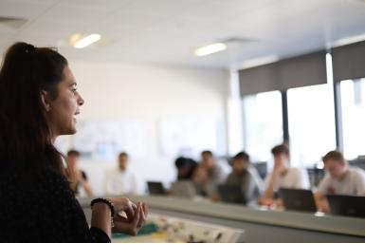
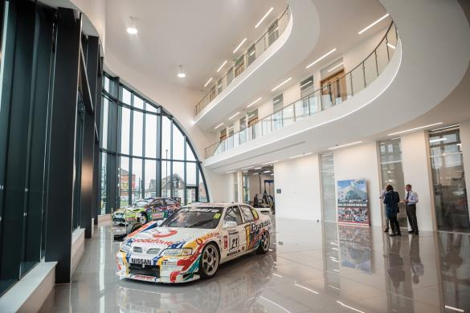
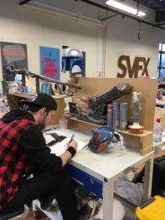
Progression to University
We’re part of the University of Bolton Group, you’ll have a unique opportunity to be part of the University’s EXCEED programme.

Slide 4
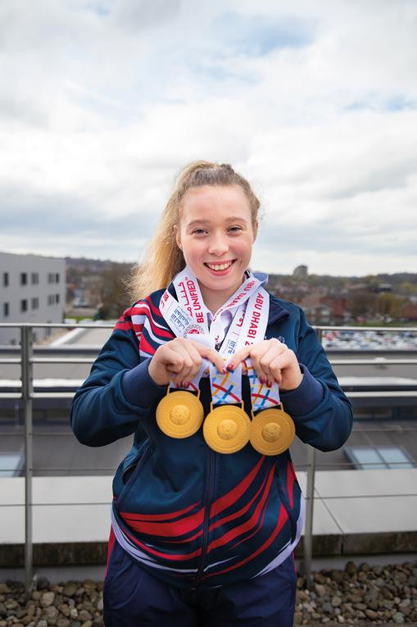

TRIPLE GOLD
MEDALIST
SPECIAL OLYMPICS
2019
Gifted & Talented Programme
Additional qualifications to complement your study programme
Individualised support to help you reach your potential

Slide 5



EXCEED Programme
EXCEED will help learners to become, amongst others, a….
• Future Engineer
• Future Creative
• Future Business Leader
• Future Health Professional
• Future Scientist

Slide 6





Support and Wellbeing
Financial:
FREE travel
FREE breakfast
FREE equipment
Bursaries
Personal:
Counselling service and multi-faith chaplaincy
Learning Mentors

Slide 7
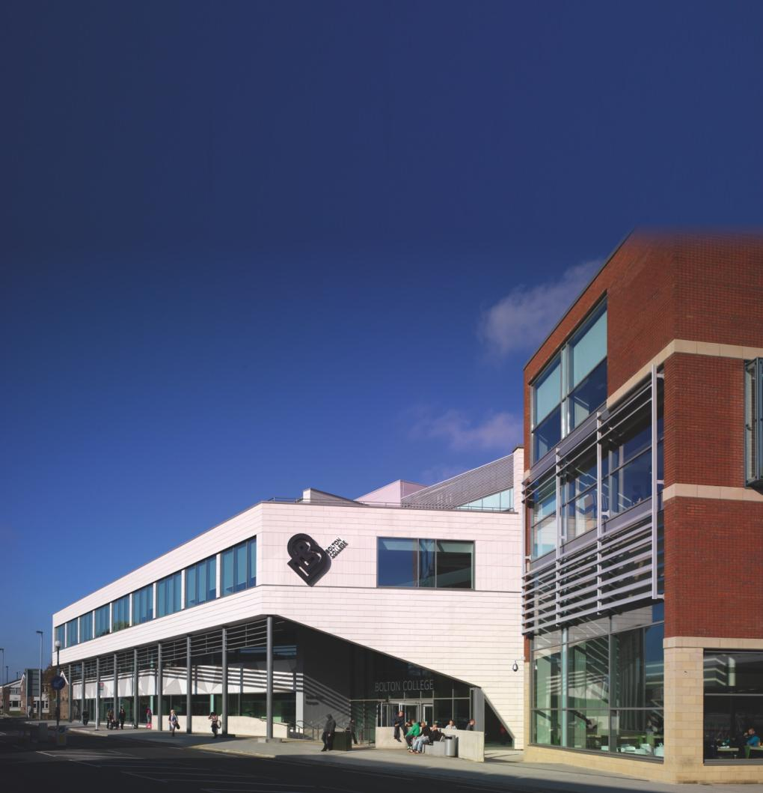


Slide 8
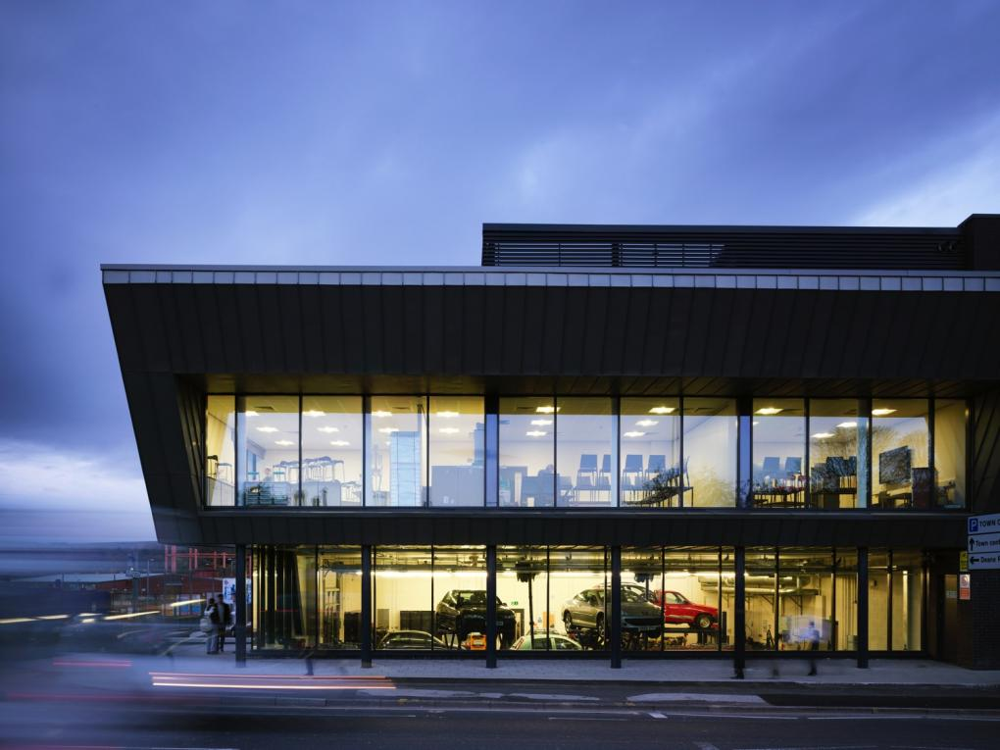

Slide 9
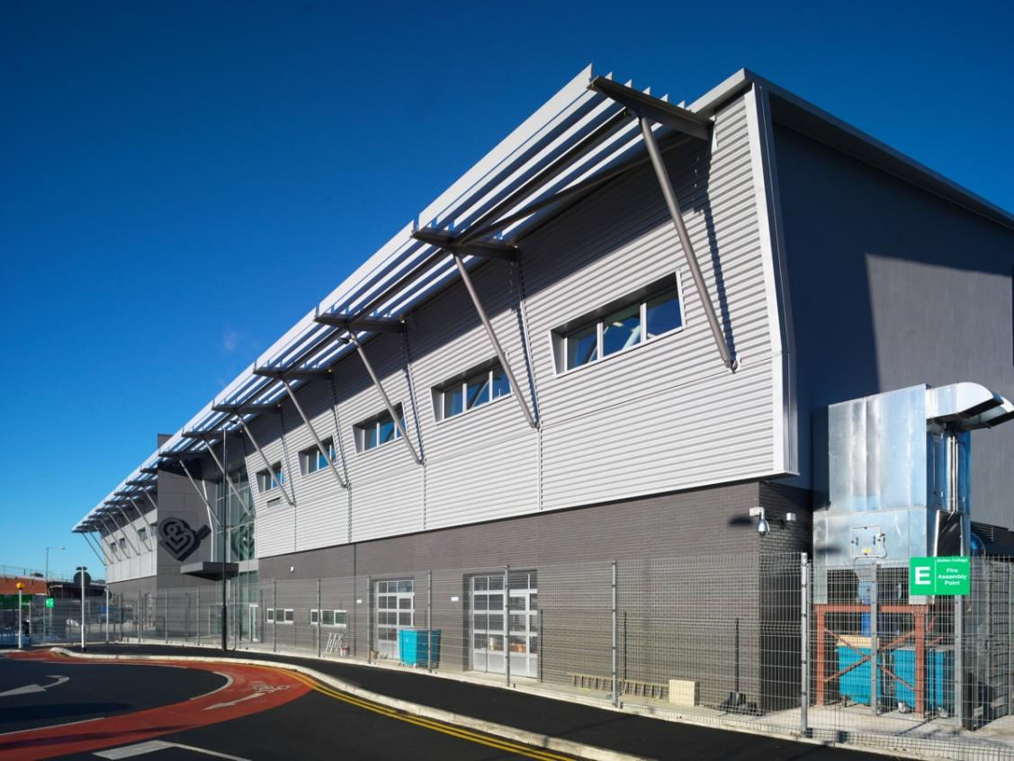

Slide 10
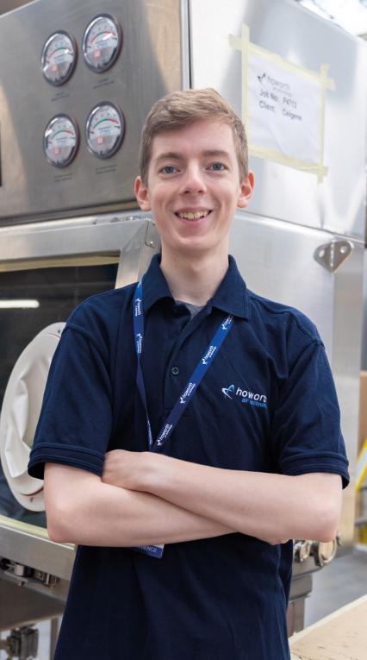
Our Students Succeed
James Snelson,
Engineering Level 3
On a full-time course with work experience.

Slide 11
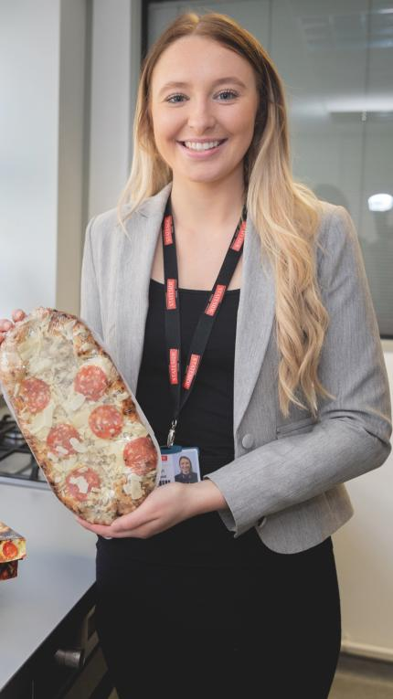
Our Students Succeed
Ashleigh Emmason
Business Apprenticeship
progressed to a Business Management Degree Apprenticeship.
NATIONAL
FESTIVAL OF LEARNING AWARDS FINALIST 2019

Slide 12
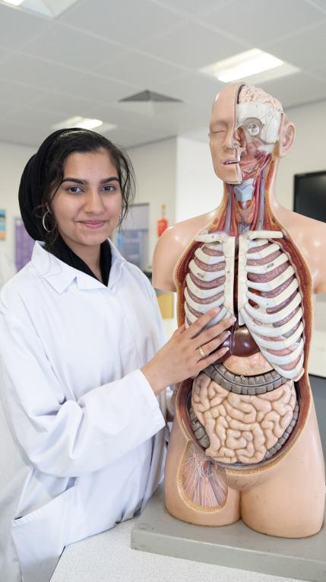
Our Students Succeed
Hajira Khalid
Applied Science
Off to university to study adult nursing.

Slide 13
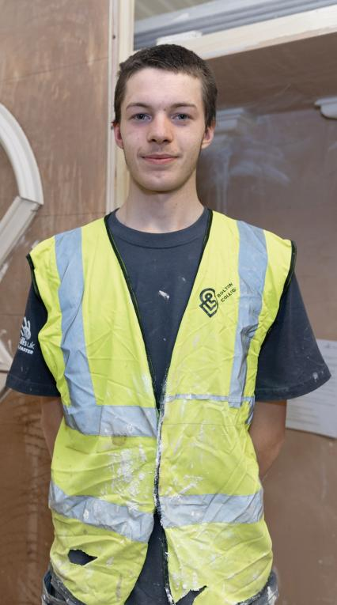
Our Students Succeed
Emilio Boaro
Plastering
Smithills School
Hoping to progress to the next stage of Skillbuild world finals in Russia!
SKILLBUILD NATIONAL FINALIST 2019

Slide 14
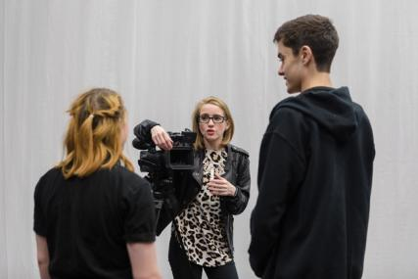
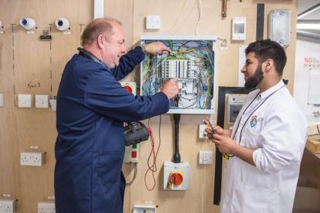
Enjoy Excellent
Teaching & Learning
‘….well-qualified subject tutors and specialist support staff’. Ofsted
Notes:
Teacher photo x 1

Slide 15

Notes:
Classroom pic for innovative

Slide 16


Our Pass – 16 to 18 bus travel
Travel around Greater Manchester, any time, FREE of charge!
Visit www.ourpass.co.uk

Slide 17
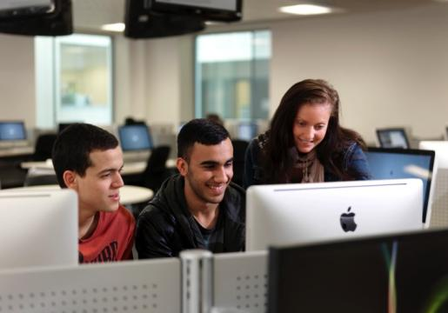
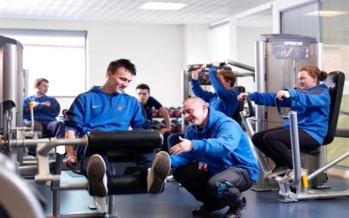

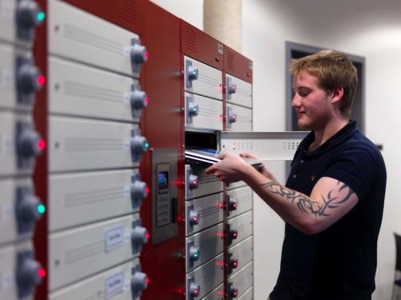
High Quality IT systems
Excellent Gym Facilities
Technology in the Classroom
Your own Personal Laptop

Slide 18
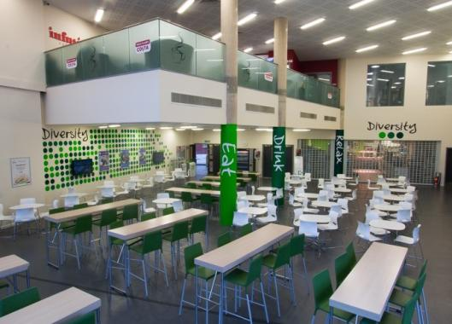
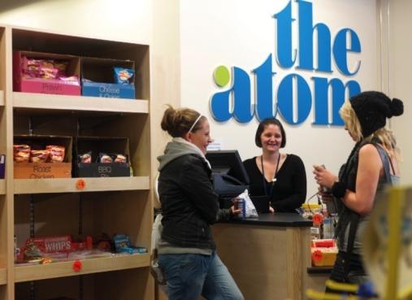
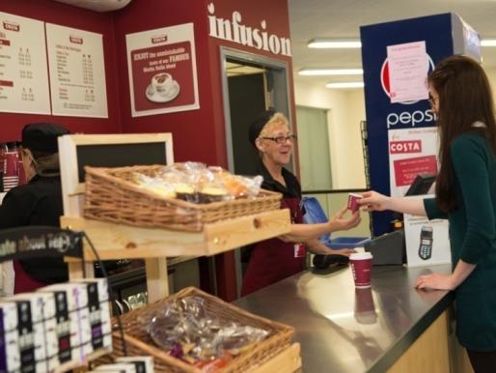

Diversity Refectory
The Atom onsite shop
Infusion, serving Costa coffee
Signature Restaurant
Notes:
Rename Wella pic ‘Wella Professionals Centre of Excellence.’
Remove Infusion, replace with ‘£4.3 million Stem Centre’, pic of STEM centre.
Remove Signature, replace with ‘High-spec Workshop’ - pic from 91 YPG.

Slide 19


Bolton College Apprenticeships
Earn While You Learn
Notes:
Change pictures and reword.

Slide 20


Why Choose an Apprenticeship?
You can earn, £117,000 more on a level 3 Apprenticeship, than those who didn’t
83%
of employers would recommend Apprenticeships*
90%
of apprentices will get a job or progress to further training*
*National Apprenticeship Service
Notes:
Get rid of middle two slides and make the remaining three bigger please. Rearrange

Slide 21

Our Study Programme & Apprenticeship Offer 2020

Slide 22


Nurse
Occupational Therapist
Physiotherapist
Radiographer

Slide 23

Fine Artist
Graphic Designer
Tattoo Artist
Web Designer

Slide 24

Aromatherapist
Beauty Therapist
Nail Technician
Salon Owner

Slide 25

Accountant
Business Consultant
Office Manager
Retail Supervisor

Slide 26


Nursery Nurse
Play Worker
Primary School Teacher
Teaching Assistant

Slide 27

Games Designer
IT Technician
Programmer
Software Developer

Slide 28

Brickwork
Carpentry & Joinery
Electrical
Multi-Skills
Painting & Decorating
Plastering
Plumbing
Professional Building
Roofing

Slide 29

Aerospace Engineer
Nuclear Engineer
Product Engineer
Rail Track Engineer

Slide 30


Slide 31

Chef
Dietician
Event Manager
Food Designer
Tourism Officer

Slide 32

Pathways to Progression:
Sample different career areas.
Art & Media
Beauty
Brickwork
Business & IT
Catering
Gardening
Hairdressing
Health & Social Care
Joinery
Motor Vehicle
Painting & Decorating
Performing Arts
Retail
Sport

Slide 33

Salon Manager
Stylist
Make-up Artist
Colour Technician

Slide 34

Barber
Barber Shop Manager
Stylist

Slide 35

Midwife
Health Care Professional
Nurse
Social Worker

Slide 36

Motor Vehicle Technician
F1 Pit Crew
Performance Engineer
Accident Repair Technician

Slide 37
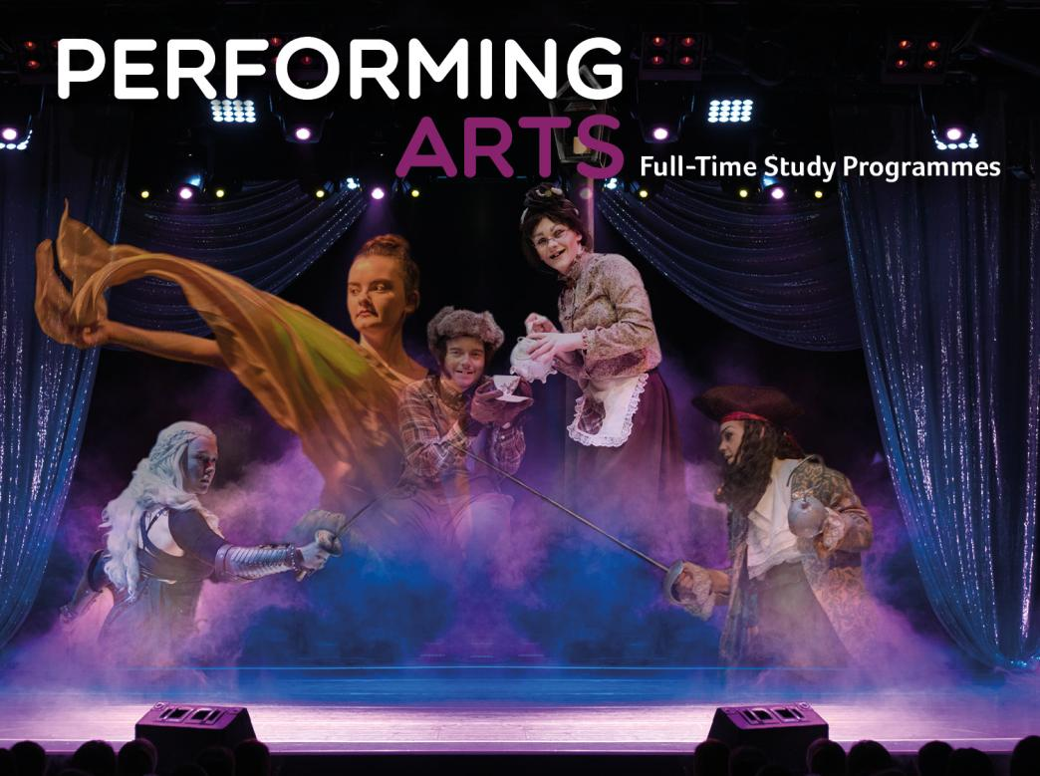
Actor
Music Therapist
Dancer
Singer

Slide 38

Armed Forces
Paramedic
Police Officer
Fire Fighter

Slide 39


Performance Coach
Gym Instructor
Personal Trainer
Physiotherapist
PE Teacher

Slide 40

Learning Mentor
Primary School Teacher
Teaching Assistant
Learning Support Worker

Slide 41






T Levels
One of 64 colleges in the country chosen to deliver
T Levels from 2021.
Choose:
Digital
Construction
Childcare
Health & Social Care

Slide 42

You can apply online at
www.boltoncollege.ac.uk/yp-application
Notes:
Screen grab for Website, UCAS OK, Paper OK, E-book change to open evening.

Slide 43

We are in the process of organizing a range of
Open events for 2020/21. We will let you know
ASAP. Please visit our website for details.

Slide 44


www.boltoncollege.ac.uk

