Slide 9
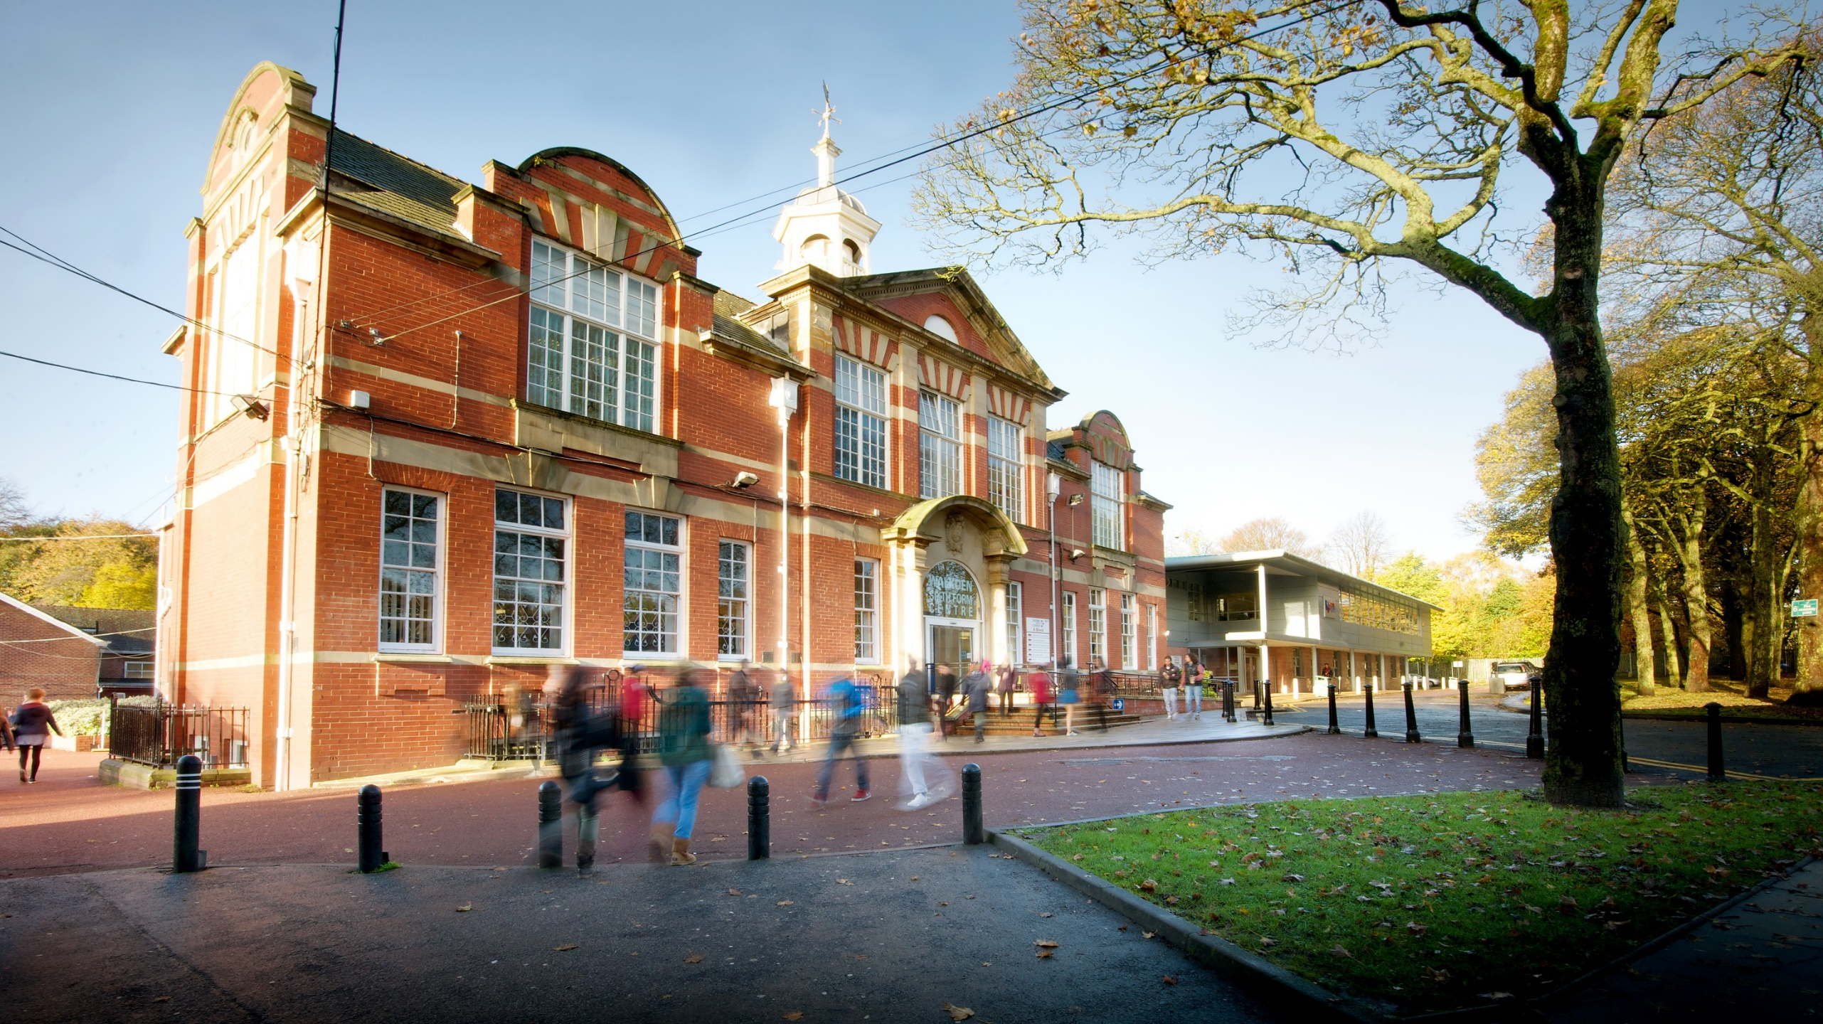
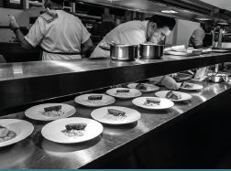
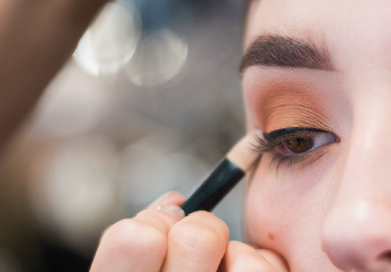
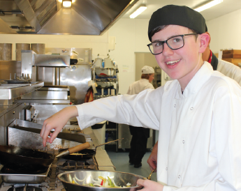
VOCATIONAL COURSES
- Beauty Therapy
- Business
- Early Years & Childcare
- Hairdressing
- Health & Social Care
- Hospitality & Culinary Arts / Bakery
- Media Make-Up
- Travel & Tourism

Slide 10
