Slide 2
Thornleigh Sixth Form
Presentation to students at Smithills School
07/10/2022

Slide 3
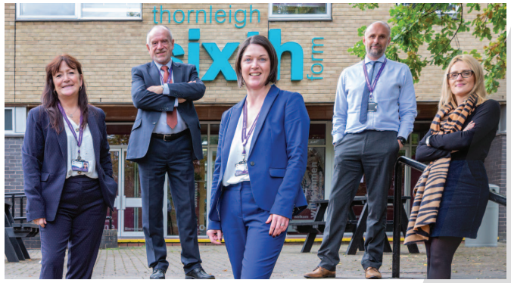
Who are we?
We are the only Catholic post-16 provision in Bolton.
We accept students from all faiths.
We have approx 300 students on roll.
Although we have entry requirements, our curriculum offer is flexible enough to offer students routes to top universities, higher apprenticeships and employment opportunities.

Slide 4
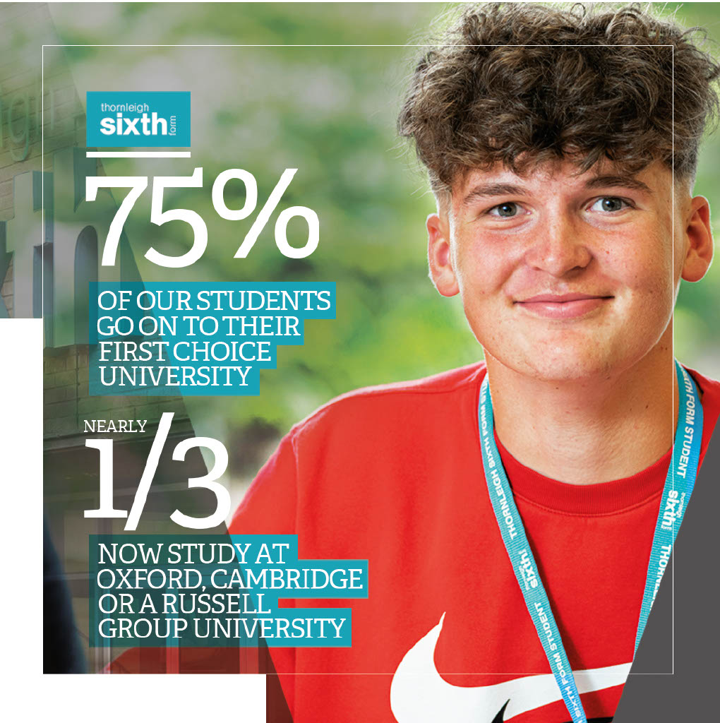
B-
99%
Average Grade
Pass Rate
A*-A
27% of all grades A*-A

Slide 5
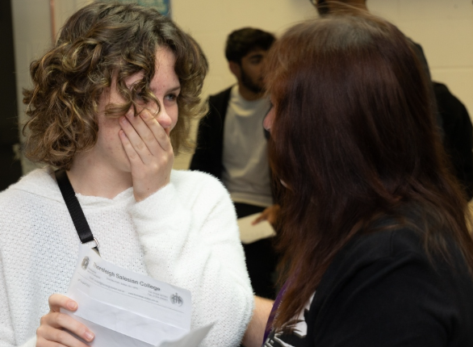
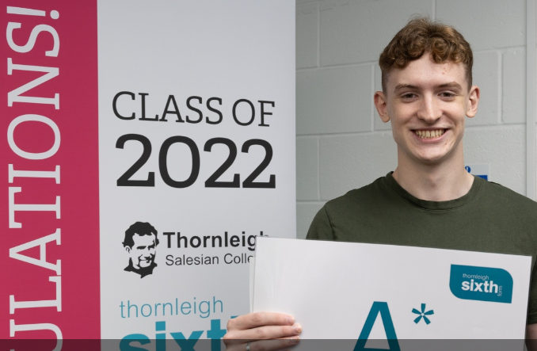
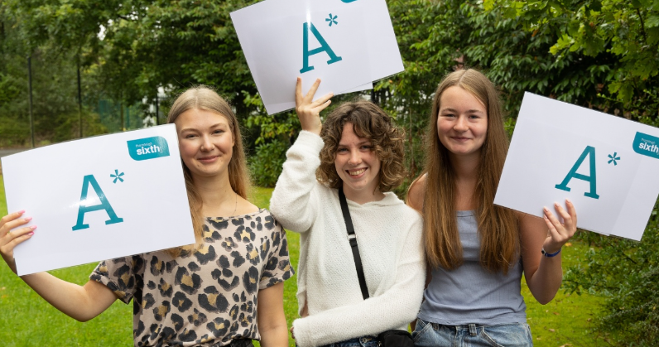
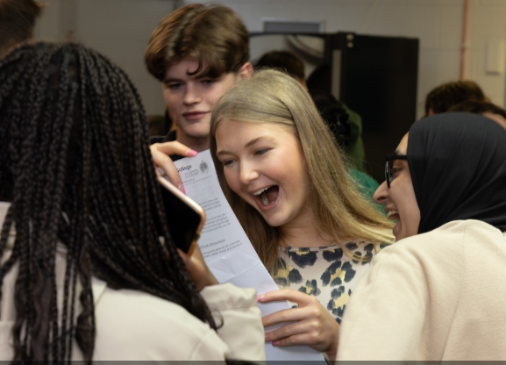
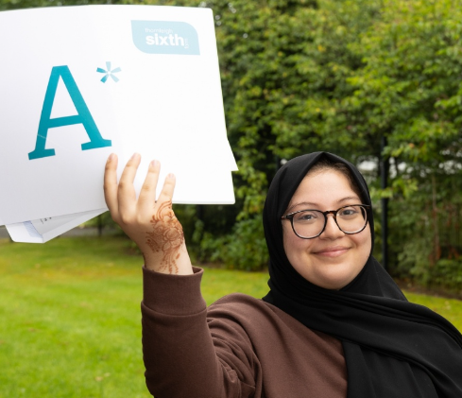
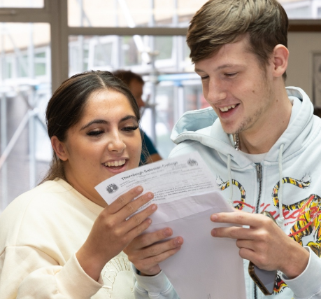
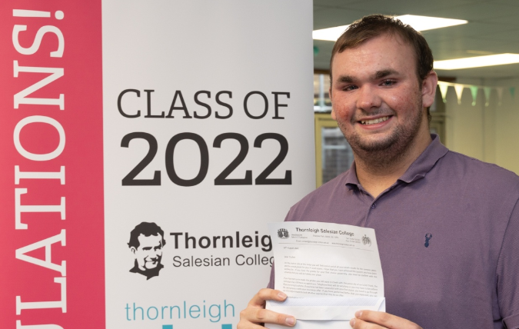
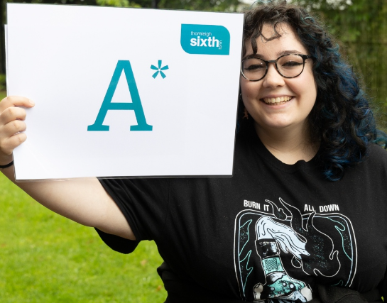
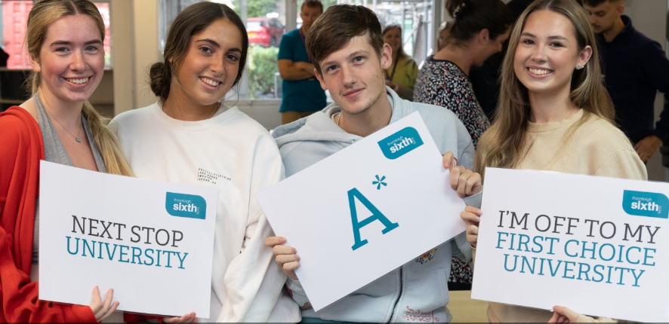

Slide 6
Destinations 2022
In 2022, 80% of our Year 13 cohort accepted places at University including University of Manchester, University of Durham, University of Liverpool, University of Oxford, University of Sheffield and University of Glasgow.
Other popular destinations in 2022 were Manchester Metropolitan University, University of Salford and Liverpool John Moores.
Students went on to study courses such as Dentistry, Medicine, Accountancy, Engineering, Business Management, Criminology, Education, History & Politics, Journalism, Law, Nursing, Optometry, Psychology……..

Slide 7
A level courses
A level Art
A level Biology
A level Business
A level Chemistry
A level Computer Science
A level Economics
A level English Language
A level English Literature
A level Further Maths
A level Geography
A level Graphic Communication
A level History
A level Maths
A level Photography
A level Physics
A level Psychology
A level Philosophy & Ethics
A level Sociology
A level Spanish

Slide 8
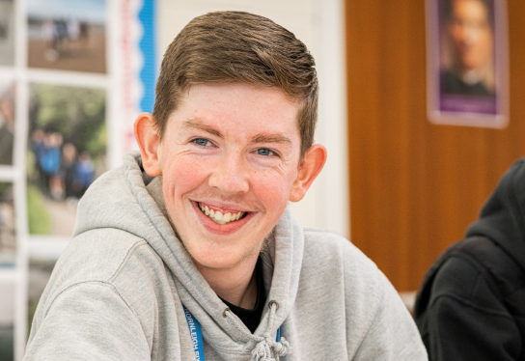
Vocational courses
BTEC Applied Science
BTEC Children’s Play, Learning and Development
BTEC Dance
BTEC Health and Social Care
BTEC Performing Arts
BTEC Sport
Cambridge Technical Introductory Diploma in IT
Applied Diploma in Criminology

Slide 9
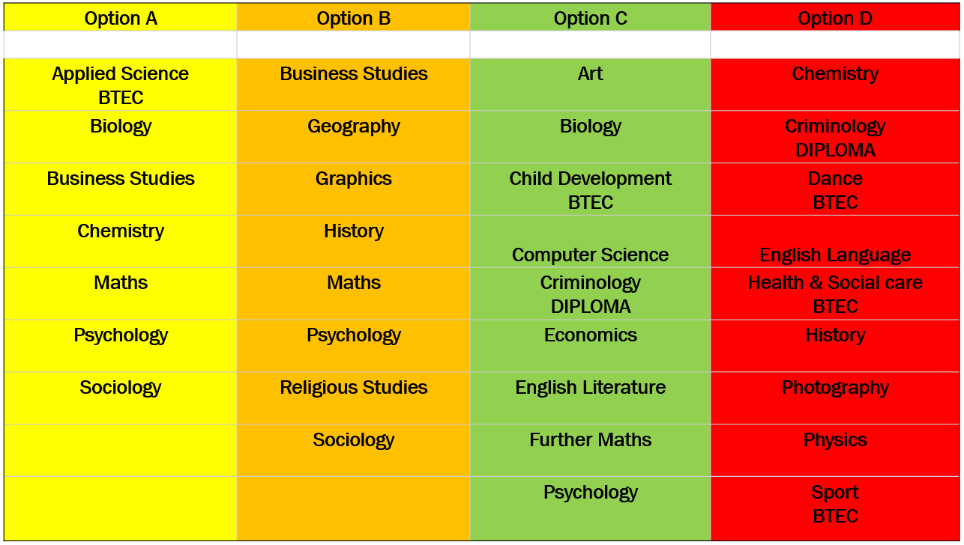
Example options matrix

Slide 10
Why Thornleigh?
Your programme of study will be tailor-made, based on your previous successes.
You will be taught by teachers who know you and can respond to your particular needs.
You will receive lots of support with UCAS applications, personal statements, apprenticeship and job applications.
Your progress will be tracked and monitored regularly to ensure that you achieve your best.
You will have many opportunities to get involved in enrichment activities and supercurricular activities.
You will be rewarded and recognised for your achievements.

Slide 11
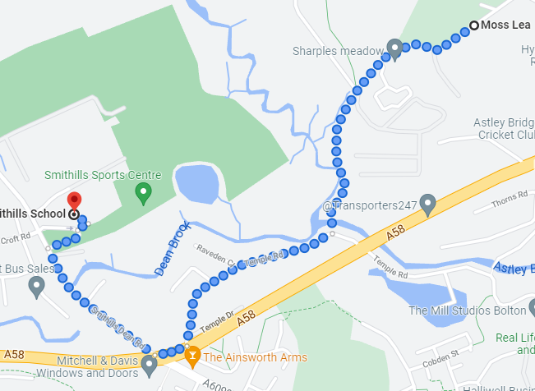
On your door step!

Slide 12
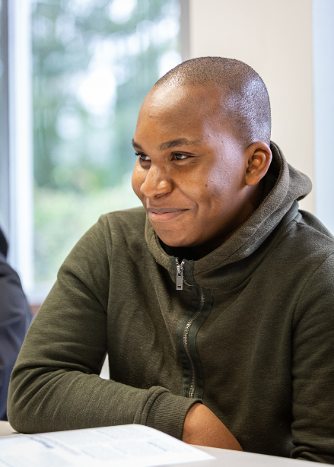
Enrichment
This presents opportunities for students to go beyond their academic studies and the normal curriculum requirements of their chosen subjects.
Aims to develop the whole student to give them the best chance of succeeding in education, work and society beyond their time at sixth form.
Helps secure competitive university places, apprenticeships and employment opportunities.
Provides opportunities to develop leadership skills and to contribute to the school and wider community.

Slide 13
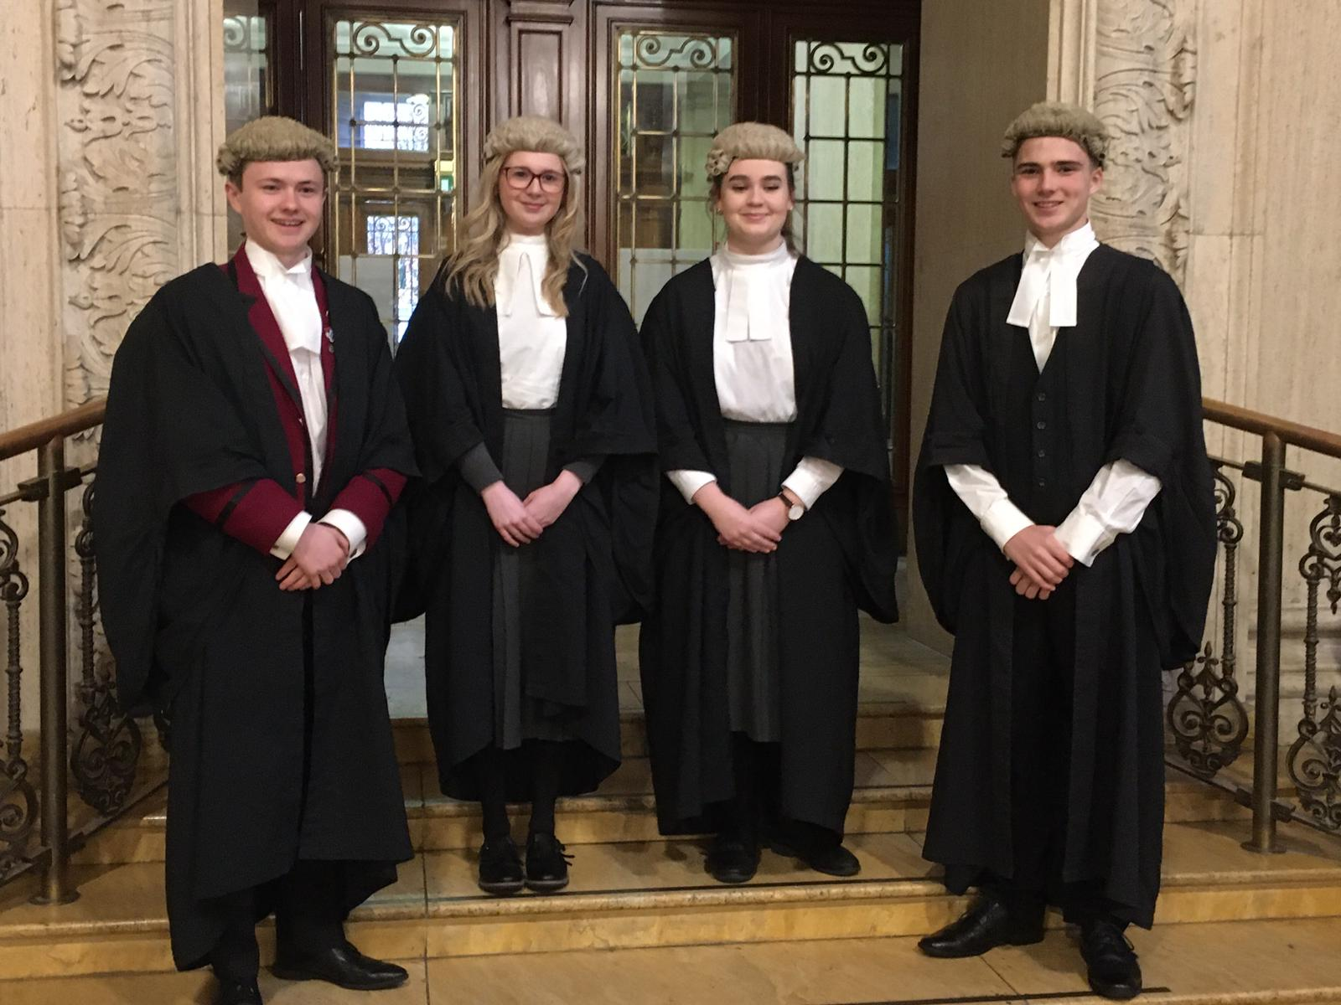
Enrichment activities
Mock Trial Competition
Conversational Spanish
British Sign Language
Business and Enterprise
Student Magazine
Young Reporter Scheme
Duke of Edinburgh
Chess and Games Club
Sport and Fitness
School Production and Choir
First Aid Training
Uniform Sustainability Project
Charity Walks
Zumba/Yoga
Crocheting
Music

Slide 14
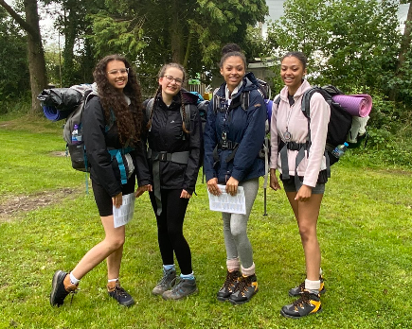
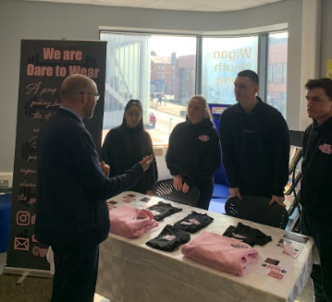
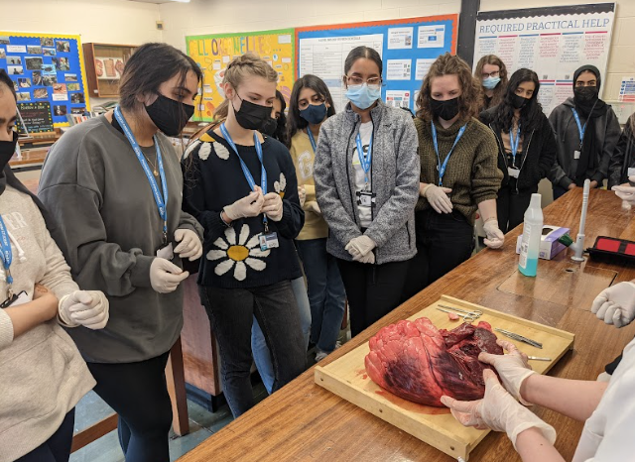
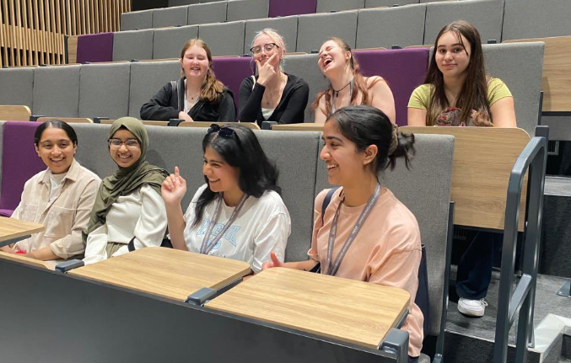
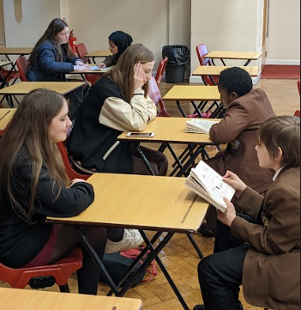
Enrichment Activities
Medical Society
Debating Society
Readers programme
Student leadership team

Slide 15
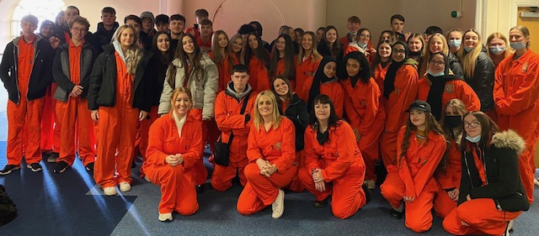
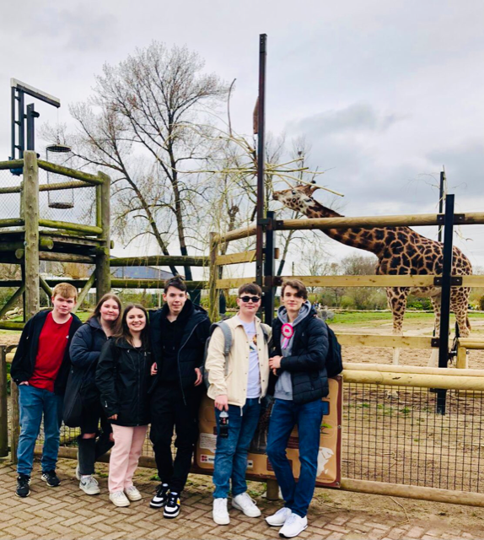
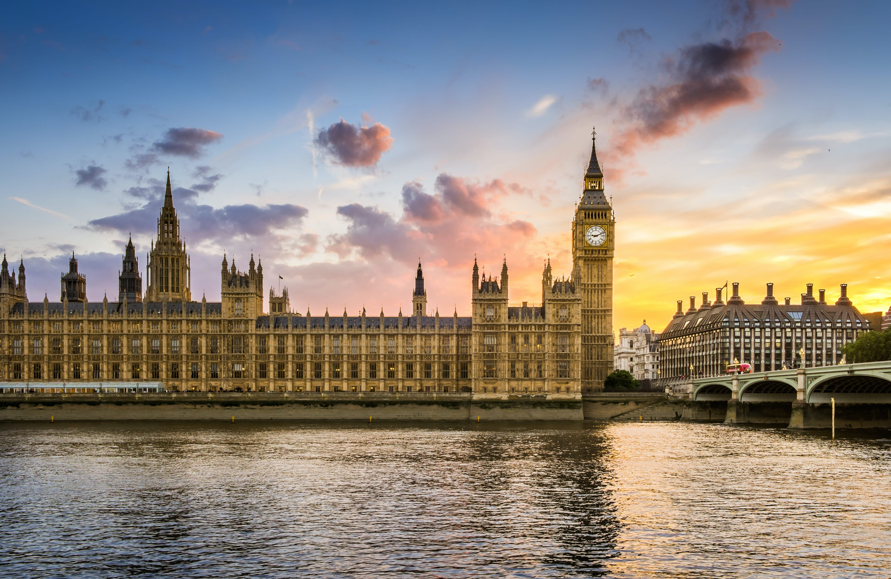
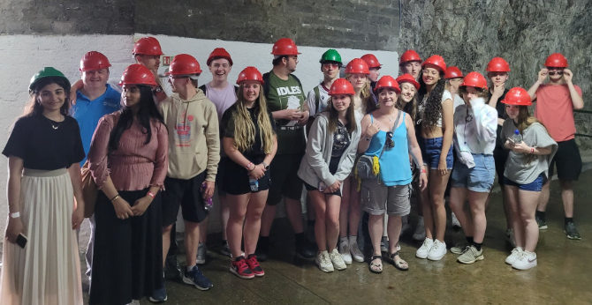
Sixth Form Trips
Vienna, Austria
Berlin, Germany
Chester Zoo
Shrewsbury Prison Trip
Blood Brothers Theatre Trip
Crown Court
Parliament
Army Residential
Turing Project e.g. Gibraltar
Anderton Centre
Bio & Geog field trip
Safe drive trip

Slide 16
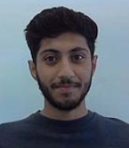
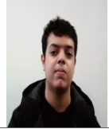
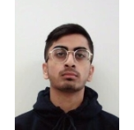
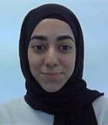
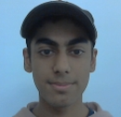
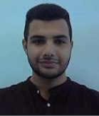
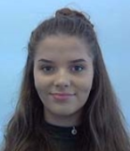
Smithills students

Slide 17
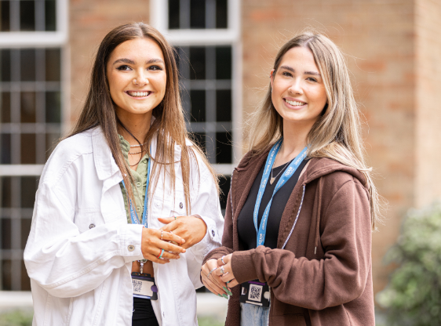
How to apply
Our application form is available on our website and will open up on Thursday 20th October.
You will need to register and then complete the application form.
A completed application does not mean you have secured a place.
You will be interviewed and then will receive an offer on the basis of securing the entry requirement grades.
For all subjects, the minimum entry requirement is 5 GCSE’s at grade 4 or above. Some courses have additional entry requirements.

Slide 18
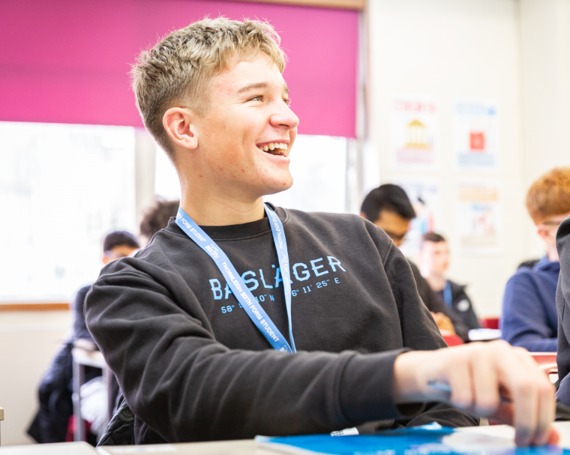
Enrolment 2023
Officially, enrolment takes place on GCSE results day.
You will log back in to your application form, enter the GCSE grades you achieved and check that you have met the entry requirements.
After this, you will be contacted by a member of staff who will check all details with you.

Slide 19
Open Evening

